Slide 1
Nonregular languages
Shakir Ullah Shah

Slide 2
Nonregular languages
Definition:
A language that cannot be defined by a regular expression is called a non-regular language.
Notes:
    – By Kleene’s theorem, a non-regular language can also not be accepted by any FA or TG.
    – All languages are either regular or non-regular; none are both.
The languages PALINDROME and PRIME are the examples of nonregular languages.

Slide 3
Example
Consider the language L = {Λ, ab, aabb, aaabbb, …} i.e. {a^{n} b^{n} : n=0,1,2,3,…}
Suppose, it is required to prove that this language is nonregular.
  Let, contrary, L be a regular language then by Kleene’s theorem it must be accepted by an FA, say, F.
  Since every FA has finite number of states then the language L (being infinite) accepted by F must have words of length more than the number of states. Which shows that, F must contain a circuit.

Slide 4
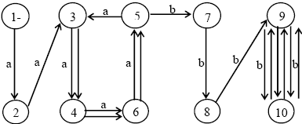
Example Cont….
For the sake of convenience suppose that F has 10 states. Consider the word a⁹ b⁹ from the language L and let the path traced by this word be shown as under.

Slide 5
Example Cont….
But, looping the circuit generated by the states 3,4,6,5,3 with a-edges once more, F also accepts the word a⁹⁺⁴ b⁹, while a¹³ b⁹ is not a word in L.
It may also be observed that, because of the circuit discussed above, F also accepts the words a⁹ (a⁴)^{m} b⁹, m=1,2,3, …
Moreover, there is another circuit generated by the states 9,10,9. Including the possibility of looping this circuit, F accepts the words a⁹ (a⁴)^{m} b⁹ (b²)^{n} where m,n=0,1,2,3,…(m and n not being 0 simultaneously). Which shows that F accepts words that are not belonging to L.

Slide 6
Example Cont….
Similarly for finding FAs accepting other words from L, they will also accept the words which do not belong to L.
Thus there is no FA which accepts the language L. which shows, by Kleene’s theorem, that the language L can’t be expressed by any regular expression.
It may be noted that apparently a^{n} b^{n} seems to be a regular expression of L, but in fact it is not.

Slide 7
Summary
In summary, we can always choose a word in L that is large enough so that its path through the FA has to contain a circuit.
  Once we find that some path with a circuit can reach a final state, we ask ourselves what happens to a path that is just like the first one, but that loops around the circuit one extra time and then proceeds identically through the machine.
  The new path also leads to the same final state, but it is generated by a different input string which is not in the language L.
  We then can conclude that there is no FA that can accepts all the words in L and only the words in L. Therefore, L is non-regular.
This idea is called the pumping lemma discovered by Bar-Hillel, Perles, and Shamir in 1961. It is called “pumping” because we pump more letters into the middle of the words. It is called “lemma” because it is used as a tool to prove other results (i.e., certain specific languages are non-regular).

Slide 8
Theorem 13
Let L be any regular language that has infinitely many words. Then there exist some three strings x, y, and z (where y is not the null string) such that all the strings of the form
xy^{n}z for n = 1, 2, 3, …
are words in L.

Slide 9
Proof of theorem 13
Since L is regular, there is an FA that accepts exactly the words in L.
Let w be some word in L that has more letters than there are states in FA.
When w generates a path through the machine, the path cannot visit a new state for each letter read, because there are more letters than states. Therefore, the path must at some point revisit a state that it has already visited. In other words, the path contains a circuit in it.

Slide 10
Proof of theorem 13 contd.
Let’s break the word w up into 3 parts:
  1. Part 1: Starting at the beginning, let x denote all the letters of w that lead up to the first state that is revisited. Note that x may be the null string if the path revisits the start state as its first revisit.
  2. Part 2: Starting at the letter after the substring x, let y denote the substring of w that travels around the circuit coming back to the same state the circuit began with. Because there must be a circuit, y cannot be the null string, and y contains the letters of w for exactly one loop around this circuit.
  3. Part 3: Let z be the rest of w, starting at the letter after y and going to the end of the string w. Note that z could be null, or the path for z could also loop around the y-circuit or any other. That means that what z does is arbitrary.
Clearly, from the definitions of these substrings, we have w = xyz. Recall that w is accepted by the FA.

Slide 11
Proof of Theorem 13 contd.
What is the path for the input string xyyz?
This path follows the path for w in the first part x and leads up to the beginning of the place where w looped around a circuit.
Then like w, it inputs the substring y, which causes the machine to loop back to this same state again.
Then, again like w, it inputs the substring y, which causes the machine to loop back to this same state another time.
Finally, just like w, it proceeds along the path dictated by the substring z and ends at the same final state that w did.
Hence, the string xyyz is accepted by this machine and therefore must be in the language L.

Slide 12
Proof of Theorem 13 contd.
Similarly, the strings xyyyz, xyyyyz, ... must also be in L.
In other words, L must contain all strings of the form:
xy^{n}z for n = 1; 2; 3; …

Slide 13
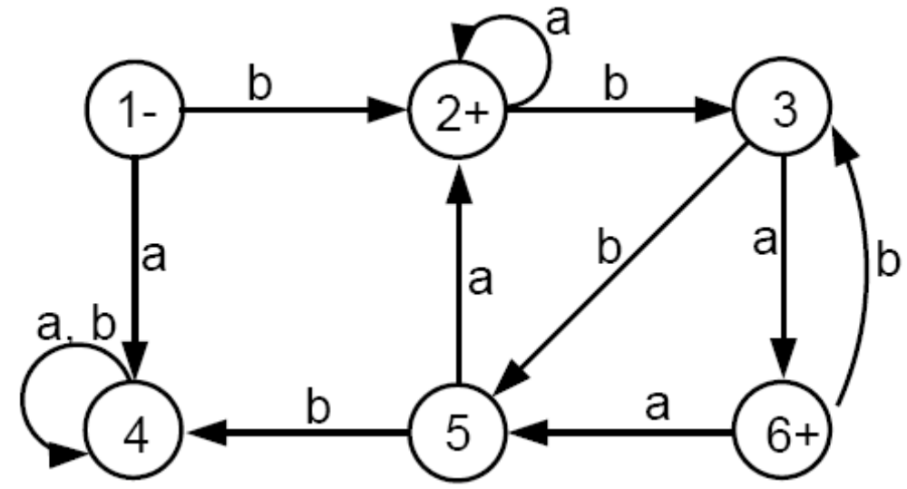
Example
Consider the following FA that accepts an infinite language and has only six states:
Consider the word w = bbbababa

Slide 14
Example contd.
The x-part goes from the - state up to the first circuit: substring b
The y-part goes around the circuit consisting of states 2, 3, and 5: substring bba
The z-part is substring baba
What happens to the input string xyyz = (b)(bba)(bba)(baba)?
This string will loop twice around the circuit and is accepted.
The same thing happens with xyyyz, xyyyyz, and in general, for xy^{n}z.

Slide 15
Let us use Theorem 13 to show again that the language L = {a^{n}b^{n}} is not regular.
If L is regular then Theorem 13 says that there must be strings x, y, and z such that all words of the form xy^{n}z are in L.
A typical word of L looks like this: aaa…aaaabbbb…bbb. How to break it into x, y, and z?
If y contains entirely a’s, then when we pump it to xyyz, this string will have more a’s than b’s, which is not allowed in L.
Similarly, if y is composed of only b’s then xyyz will have more b’s than a’s, and is not allowed in L either.

Slide 16
If y consists of both as and bs. In this case the substring xyyz may have the same number of as and bs, but they will be out of order with some as before bs.
  Therefore, xyyz can not be a word in L.
The above arguments show that the pumping lemma cannot apply to L and therefore L is not regular.

Slide 17
Example
Let EQUAL be the language of all words (over the alphabet ∑ = {a; b}) that have the same total number of a’s and b’s:
EQUAL = {Λ; ab; ba; aabb; abab; abba; baab; baba; bbaa; aaabbb; …}
Can you show that EQUAL is not regular?
Let L = {a^{n}ba^{n}} = {b; aba; aabaa; …}
Can you show that L is not regular?

Slide 18
Theorem 14
Let L be an infinite language accepted by a finite automaton with N states. Then, for all words w in L that have more than N letters, there are strings x, y, and z, where y is not null and length(x) + length(y) does not exceed N, such that w = xyz and all strings of the form xy^{n}z for n = 1; 2; 3; … are in L.
This is obviously just another version of Theorem 13 (the pumping lemma), for which we have already provided the proof.
The purpose of stressing the issue of lengths is illustrated in the following example.

Slide 19
Example
We will show that the language PALINDROME is not regular.
We cannot use the first version of the pumping lemma (Theorem 13)vbecause the strings
x = a; y = b; z = a
satisfy the lemma and do not contradict the language, since all the strings of the form xy^{n}z = ab^{n}a are words in PALINDROME.
So, we will use the second version of the pumping lemma (Theorem 14) to show that PALINDROME is non-regular.

Slide 20
Example contd.
Suppose for the contrary that PALINDROME were regular, then there would exist some FA that accepts it.
For the sake of argument, assume that this FA has 77 states.
Then, the palindrome w = a⁸⁰ba⁸⁰ must be accepted by this FA.
Because w has more letters than the FA has states, by Theorem 14 we can break w into three parts: x, y, and z.
Since length(x) + length(y) ≤ 77 (by Theorem 14), the strings x and y must both be made of all a’s, since the first 77 letters of w are all a’s.

Slide 21
Hence, when we form xyyz, we are adding more a’s to the front of w, but we are not adding more a’s to the back of w.
Thus, the string xyyz will be of the form
a^{(more than 80)}ba⁸⁰
and obviously is NOT a palindrome.
This is a contradiction, since Theorem 14 says that xyyz must be a palindrome. Hence, the language PALINDROME is NOT regular.

